Slide 1
Web scraping to gain company insights
Task 1

Slide 2
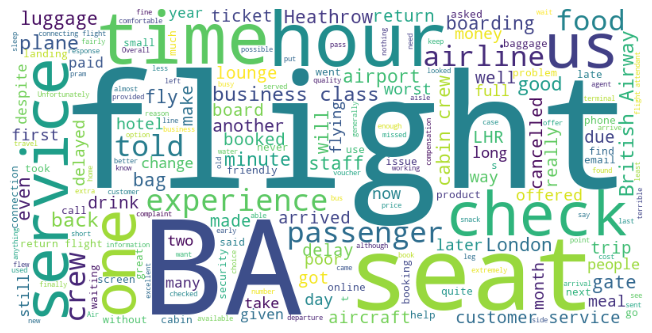
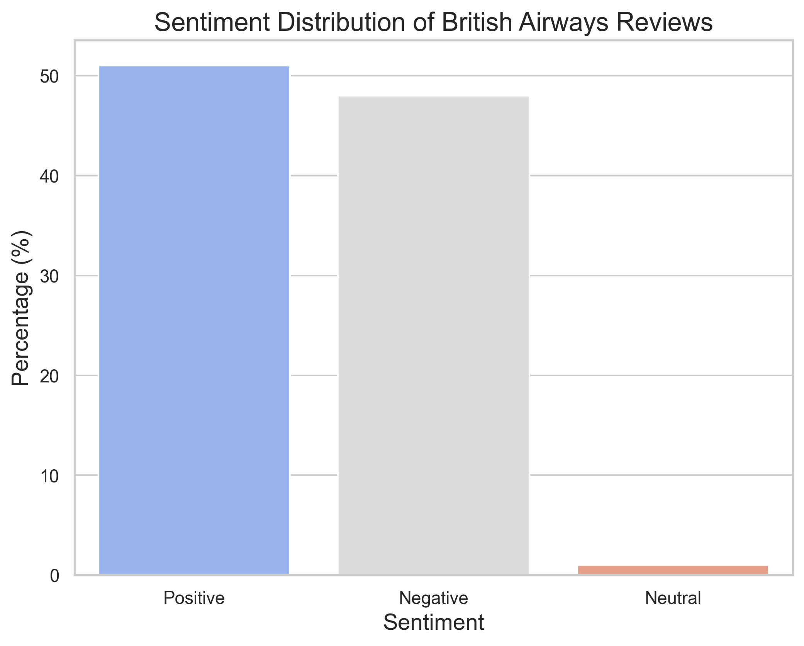
Key information – 100 Reviews
Most Used Words
Feedback Information
Customers’ quantified satisfaction:
Flight Experience: 339 mentions
Service: 127 mentions
Amenities: 103 mentions
  Total: 569 mentions
Customers’ quantified disssatisfaction:
Flight Experience: 278 mentions
Service: 100 mentions
Amenities: 63 mentions
  Total: 441 mentions
~29%
Satisfaction > Dissatisfaction

